Slide 1
ISO Emerging Issues: Internet of Things
CPCU Central NJ
2016
Notes:
[click for next slide]

Slide 2

Agenda
Overview of IoT
Uses and Potential Impacts
Litigation & Regulation
Possible Exposures
Insurance Responses
Future of IoT

Slide 3

Overview
What do we mean when we say IoT?
What kind of sensors can be considered as IoT?
What types of wireless systems are typically part of IoT?

Slide 4
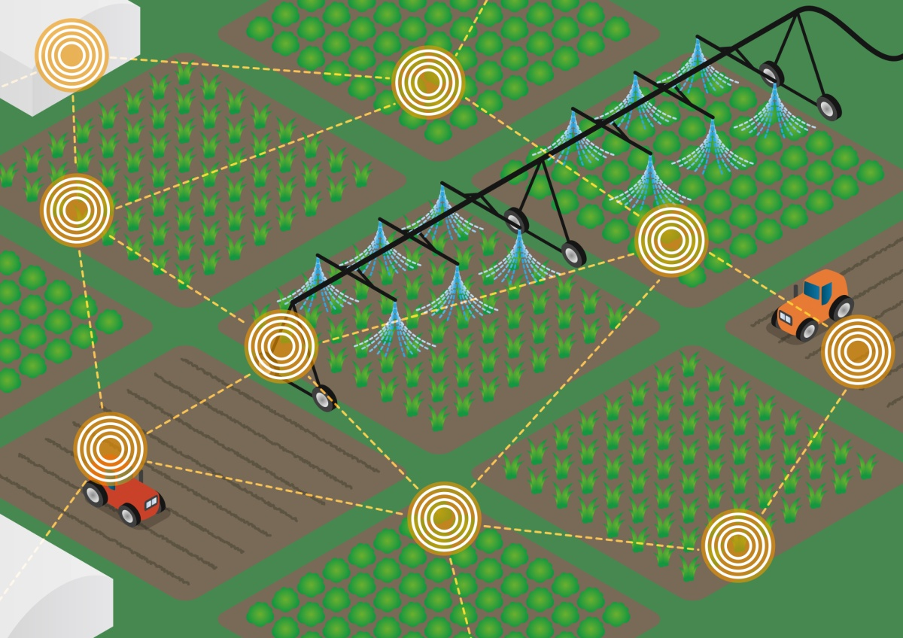
Uses and Potential Impacts
Healthcare
Farming
Manufacturing
Supply Chain
Other Cases

Slide 5

Litigation & Regulation
US Department of Commerce
US House of Representatives
Federal Trade Commission
Federal Railroad Administration
Other

Slide 6

Possible Exposures
Connected Homes & Personal Devices
Connected Vehicles
General Cybersecurity
Miscellaneous

Slide 7

Possible Exposures - Connected Homes & Personal Devices

Slide 8
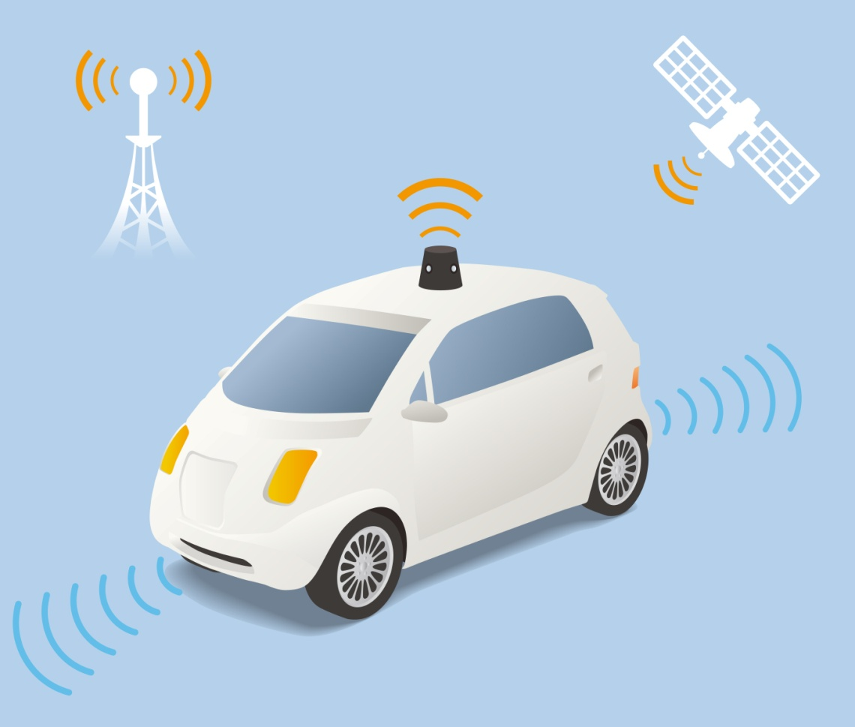
Possible Exposures – Connected Vehicles

Slide 9

Possible Exposures - Cybersecurity

Slide 10
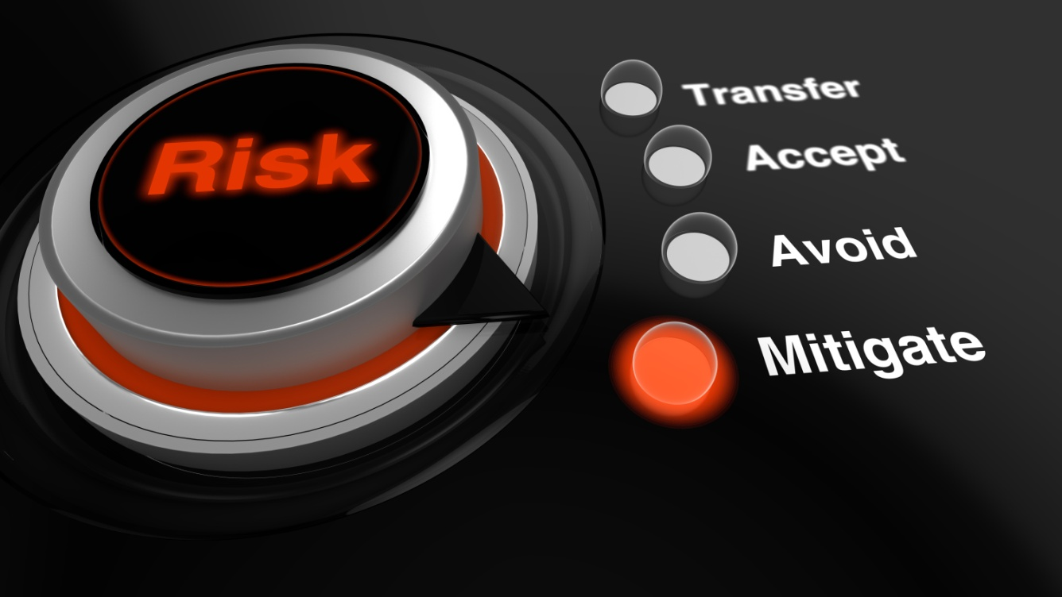
Insurance Responses
Surveys
Investments
Consumer Discounts

Slide 11

Future of IoT
Potential Uses
Estimated Industry Growth
Estimated Industry Value
Data

Slide 12
Contact Information
Christopher Sirota, CPCU
Lead
Emerging Issues Product Development
christopher.sirota@verisk.com
(201) 469 2712
No part of this presentation may be copied or redistributed without the prior written consent of ISO. This material was used exclusively as an exhibit to an oral presentation. It may not be, nor should it be relied upon as reflecting, a complete record of the discussion.

Slide 13
No part of this presentation may be copied or redistributed without the prior written consent of ISO.
This material was used exclusively as an exhibit to an oral presentation.
It may not be, nor should it be relied upon as reflecting, a complete record of the discussion.

