Slide 1
Using Data to improve the Workers Compensation Underwriting results
June, 2016
Notes:
[click for next slide]

Slide 2
Since 1990, the Workers Compensation insurance combined ratio has rarely been under 100
Workers Compensation Insurance Combined Ratio (Private Carriers)
A combined ratio is the sum of the loss ratio, the loss adjustment expense (LAE) ratio, the dividend ratio, and the underwriting expense ratio. The loss, LAE, and dividend ratios are calculated as ratios to earned premium. The underwriting expense ratio is calculated as a ratio to written premium to provide a better match of the timing of the numerator and denominator.
Source: NCCI

Slide 3

Challenges facing Workers Compensation underwriters
Need to differentiate risks and make better selections
Information is often provided by insured or agent
Researching information is time consuming and requires multiple sources
Policies are written based on estimated exposure
Audits are traditionally
performed at renewal

Slide 4
Given the right amount of time, data, and analysis carriers can achieve ideal risk selection
Data
Accumulation
Accuracy
Analysis
Time

Slide 5
Risk selection is a time consuming process that often results with rating based on incomplete or inaccurate data
Ideal risk selection:
Complete data
Accurate data
Data analysis
Minimal time
Data
Accumulation
Accuracy
Analysis
Typical scenario:
Incomplete data
Unverified data
Limited time for analysis
Long time to quote
Time

Slide 6
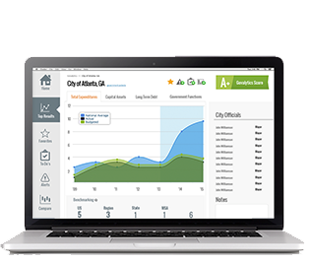
There is point of sale information available to help Workers Compensation Underwriters better assess risk
Use point of sale business, hazard, and property-specific information to improve underwriting results
Business
Hazard
Workers Compensation
underwriting data
Business Classification
Confirm SIC and NAICS
Analysis on premium impact due to inaccurate WC class code
WC companion class codes
Insights into secondary and tertiary business classifications
Actual spend data can identify potential business misclassifications
OSHA Inspections
OSHA inspection results
Open OSHA violations
Hazardous Materials
Hazardous chemical shipment
Chemical and oil spills
Business Information
Number of employees
Sales
Recent business news
Property
Injury and Fatality Benchmarks
Industry and state-specific injury and fatality rates
Medical Facilities
Time and distance to medical facilities
Business Credit
Business credit rating
Benchmarking business credit rating
Bankruptcy and liens
Presence of alcohol
Liquor license
Property Characteristics
Building characteristics (number of stories, size, hazards, etc.)

Slide 7
A robust 360º view of the business allows for better informed underwriting decisions
Informed underwriting is a critical competency for carriers. Accurate and complete applicant data can help improve underwriting results.
1
Increase efficiency
      Save time
      Deliver quotes quicker than competition
Enhance risk management
      Make decisions with accurate information
Unparalleled risk selection capabilities
  Optimize risk selection and pricing—and profitability
2
3

Slide 8
The use of accurate, unbiased, and centralized data provides the underwriter with time and analytics for optimal risk selection
Ideal risk selection:
Complete data
Accurate data
Data analysis
Minimal time
Data
Accumulation
Accuracy
Analysis
Time
One data source
Additional time for analysis
Speed to quote
Data
Complete data
Unbiased verified
Data not previously used by the carrier
Typical scenario:
Incomplete data
Unverified data
Limited time for analysis
Time commitment
Time

Slide 9
Select Case Study Results

Slide 10

Employee size, business classification, and management capabilities are important criteria for proper risk selection and pricing
Employee count
Business Classification
Management capabilities

Slide 11
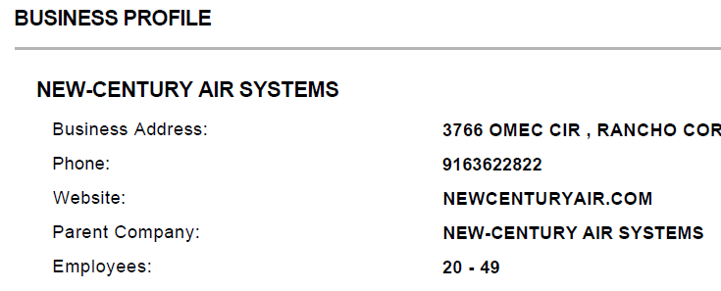
A Workers Compensation case study on proper data usage uncovered the estimated premium for risk was almost $100,000 more than original carrier estimate
Case study results
Available point of sale data
Initial carrier records
Heating and Air Conditioning contractor in CA
Number of employees is 3
Total payroll is $160K
Carrier confirmed 27 employees
Carrier: Original | Carrier: After
Number of employees = 3 | Number of employees = 27
Payroll = $160,000 | Assuming $53,333 pay per worker
WC HVAC contractor code: 5537 | WC HVAC contractor code: 5537
WC rate: $7.67/$100 payroll | WC rate: $7.67/$100 payroll
Original premium = $12,272 | Accurate premium = $110,447

Slide 12
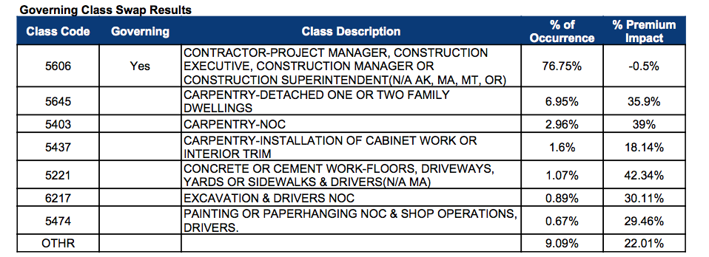
Governing Class Swap results provide insights into the historical premium impact due to audited results
Governing Class Swap results for policies when an agent or insured reports class code 5606 at policy inception
In this example 6.9% of the audits resulted in changing the governing class code to code 5645 which has a 35% impact on premium

Slide 13
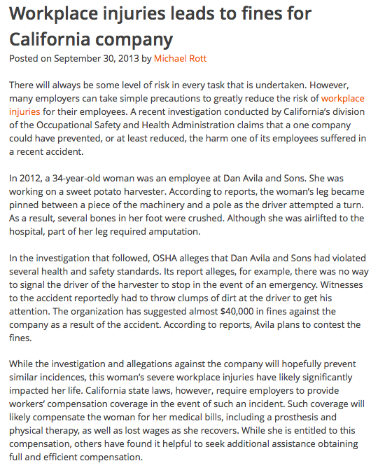
Low credit score could raise a “red flag” on management capabilities
Credit Score 392
Very High Risk
Workplace injuries lead to fines for Dan Avila & Sons
Company XYZ
Company XYZ
Agriculture company located in Northern California
Management Capabilities
OSHA since 2005
    57 total OSHA violations
    15 serious OSHA violations
Recently fined $39K by OSHA for failure to train employees in proper safety procedures, as well as neglecting to keep work areas free of obstructions, resulting in a loss of limb injury to one of their workers

Slide 14

Accurate information is important to both the carrier and the insured
Advantages for carrier:
Improved risk assessment
Adequate premium projections
Prevention of under collection
of premium from the start
Advantages for insured:
Prevent underinsurance
No surprises at end of policy term
Insured can plan for premium payments

